Slide 1
COMP 2710 Software Construction
Function Basics
Dr. Xiao Qin
Auburn University
http://www.eng.auburn.edu/~xqin
xqin@auburn.edu
Fall, 2012
These slides are adapted from notes by Dr. Walter Savitch (UCSD)
Notes:
See Lecture
Fall’09 Lec03a, Fall’11 Lec03a.
Objectives
Predefined Functions
Those that return a value and those that don’t
Programmer-defined Functions
Defining, Declaring, Calling
Recursive Functions
Scope Rules
Local variables
Global constants and global variables
Blocks, nested scopes

Slide 2
Introduction to Functions
Building Blocks of Programs
Other terminology in other languages:
  Procedures, subprograms, methods
  In C++: functions
I-P-O
  Input – Process – Output
  Basic subparts to any program
  Use functions for these "pieces"
Copyright © 2008 Pearson Addison-Wesley. All rights reserved.
3-<number>

Slide 3
Predefined Functions
Libraries full of functions for our use!
Two types:
  Those that return a value
  Those that do not (void)
Must "#include" appropriate library
  e.g.,
    <cmath>, <cstdlib> (Original "C" libraries)
    <iostream> (for cout, cin)
Copyright © 2008 Pearson Addison-Wesley. All rights reserved.
3-<number>

Slide 4
Using Predefined Functions
Math functions very plentiful
  Found in library <cmath.h>
  Most return a value (the "answer")
Example: theRoot = sqrt(9.0);
  Components:
  sqrt = name of library function
  theRoot = variable used to assign "answer" to
  9.0 = argument or "starting input" for function
  In I-P-O:
    I = 9.0
    P = "compute the square root"
    O = 3, which is returned & assigned to theRoot
Copyright © 2008 Pearson Addison-Wesley. All rights reserved.
3-<number>

Slide 5
The Function Call
Back to this assignment:
theRoot = sqrt(9.0);
  The expression "sqrt(9.0)" is known as a
  function call, or function invocation
  The argument in a function call (9.0) can be a
  literal, a variable, or an expression
  The call itself can be part of an expression:
    bonus = sqrt(sales)/10;
    A function call is allowed wherever it’s legal to use
    an expression of the function’s return type
Copyright © 2008 Pearson Addison-Wesley. All rights reserved.
3-<number>

Slide 6
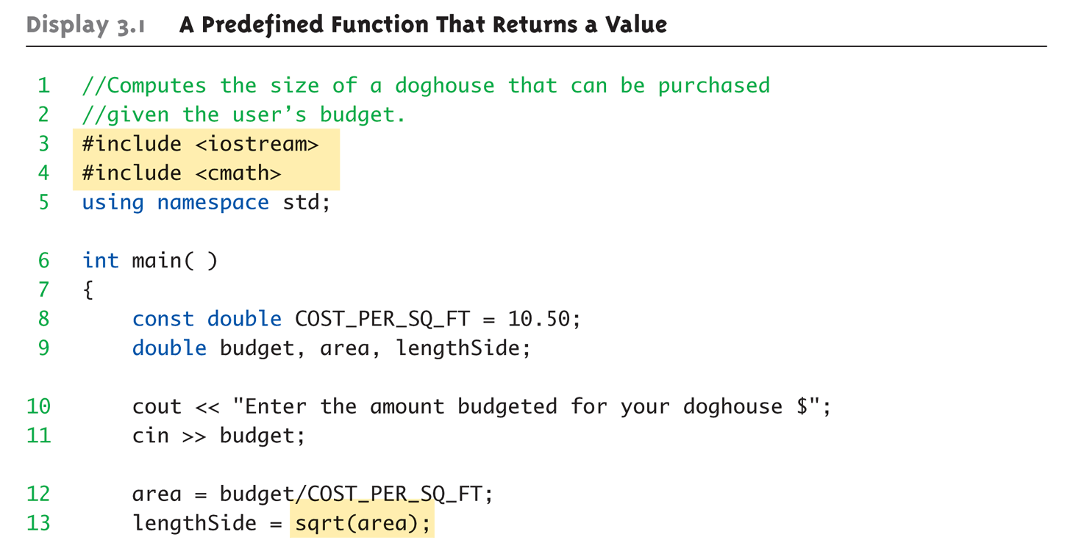
A Larger Example:
Display 3.1 A Predefined Function That Returns a Value (1 of 2)
Copyright © 2008 Pearson Addison-Wesley. All rights reserved.
3-<number>
Notes:
doghouse.cpp

Slide 7
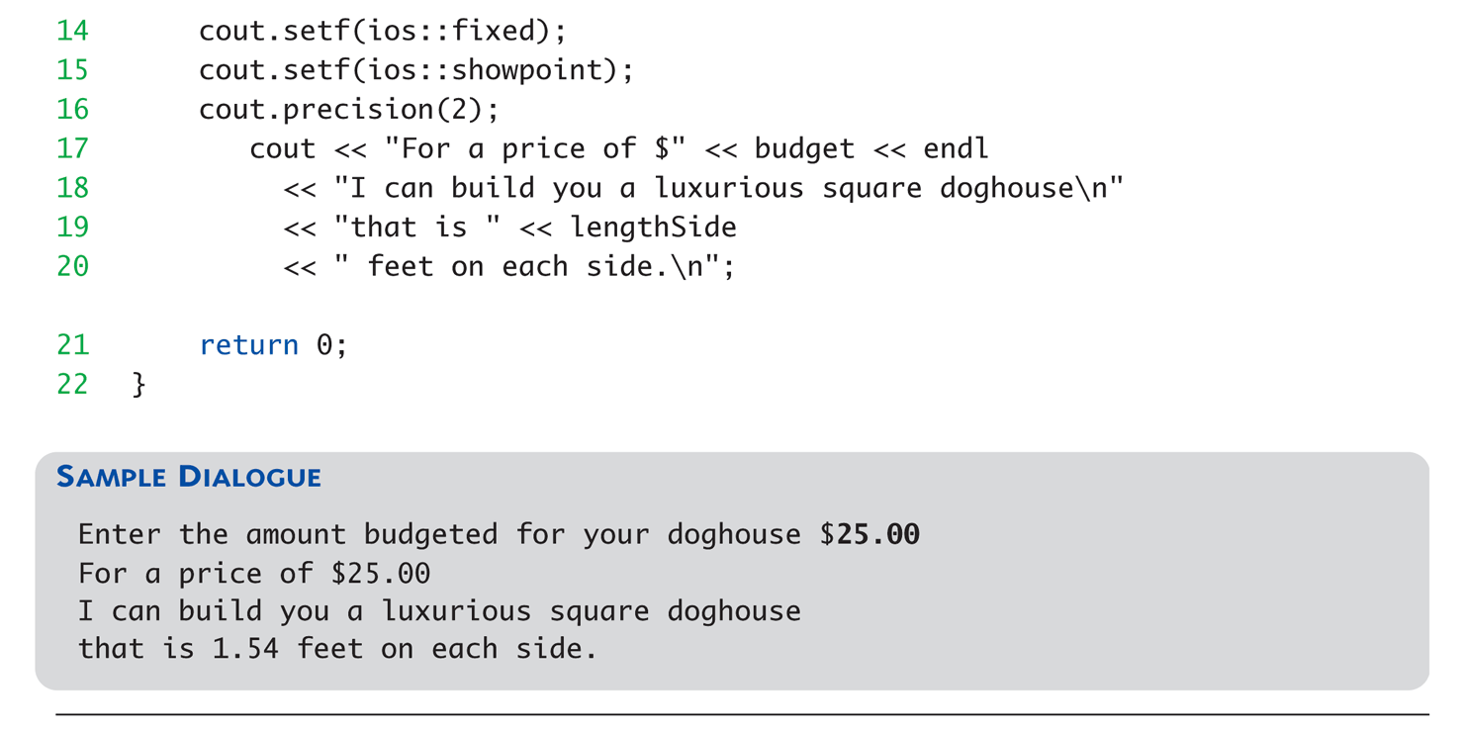
A Larger Example:
Display 3.1 A Predefined Function That Returns a Value (2 of 2)
Copyright © 2008 Pearson Addison-Wesley. All rights reserved.
3-<number>

Slide 8
More Predefined Functions
#include <cstdlib>
  Library contains functions like:
    abs() // Returns absolute value of an int
    labs() // Returns absolute value of a long int
    *fabs() // Returns absolute value of a float
  *fabs() is actually in library <cmath>!
    Can be confusing
    Remember: libraries were added after C++ was
    "born," in incremental phases
    Refer to appendices/manuals for details
Copyright © 2008 Pearson Addison-Wesley. All rights reserved.
3-<number>

Slide 9
More Math Functions
pow(x, y)
  Returns x to the power y
  double result, x = 3.0, y = 2.0;
  result = pow(x, y);
  cout << result;
    Here 9.0 is displayed since 3.0^{2.0} = 9.0
Notice this function receives two arguments
  A function can have any number of arguments, of varying data types
Copyright © 2008 Pearson Addison-Wesley. All rights reserved.
3-<number>
Notes:
Java:
strictfp class MainClass {
public static void main(String[] args) {
// Display the square root of 2 using sqrt()
System.out.print("sqrt(2.0) = ");
System.out.println(Math.sqrt(2.0));
// Calculate and display using pow()
System.out.print("pow(2.0, 0.5) = ");
System.out.println(Math.pow(2.0, 0.5));
System.out.println();
}
}

Slide 10
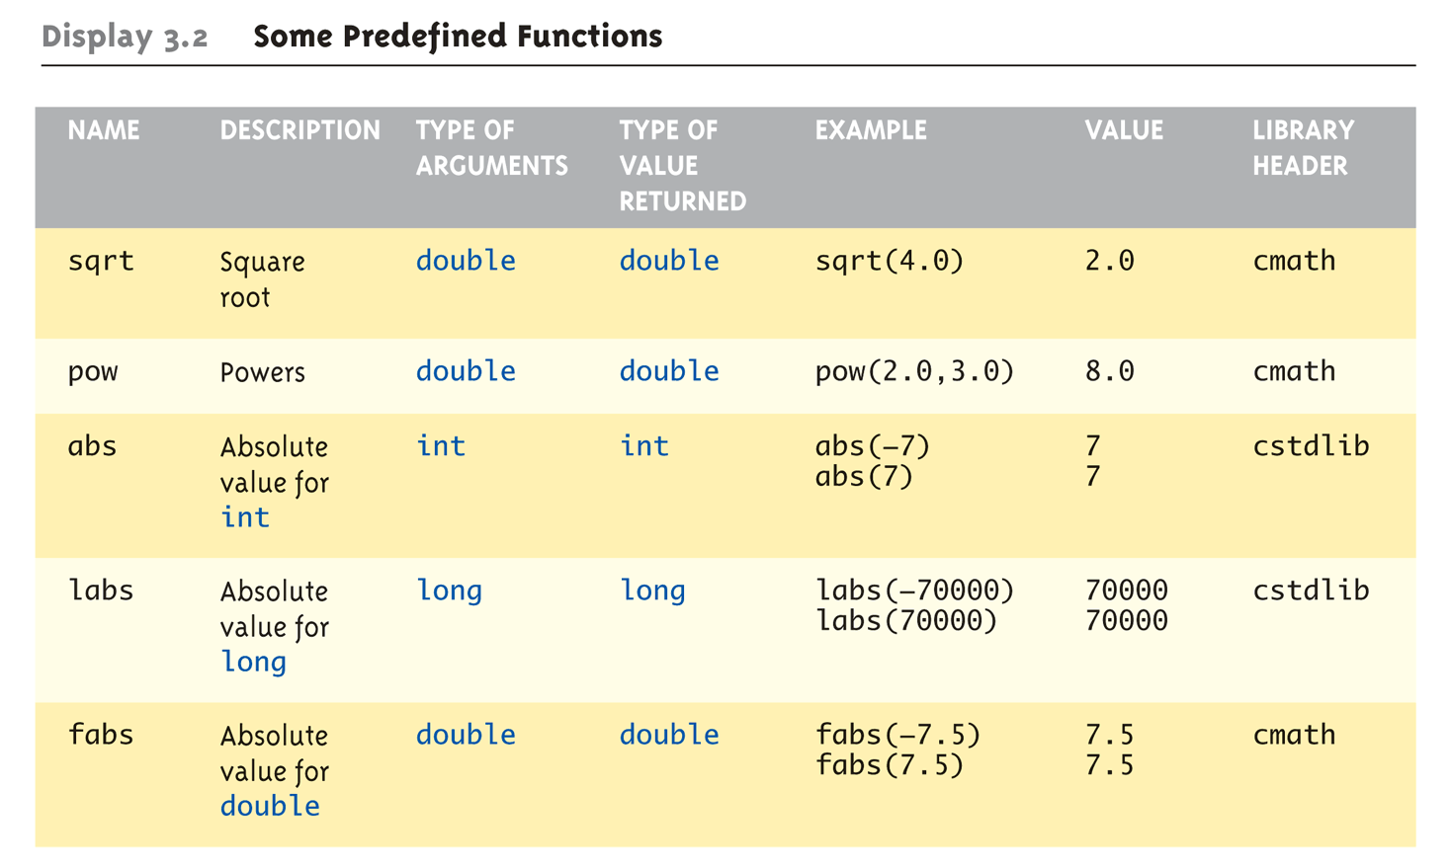
Even More Math Functions:
Display 3.2 Some Predefined
Functions (1 of 2)
Copyright © 2008 Pearson Addison-Wesley. All rights reserved.
3-<number>

Slide 11
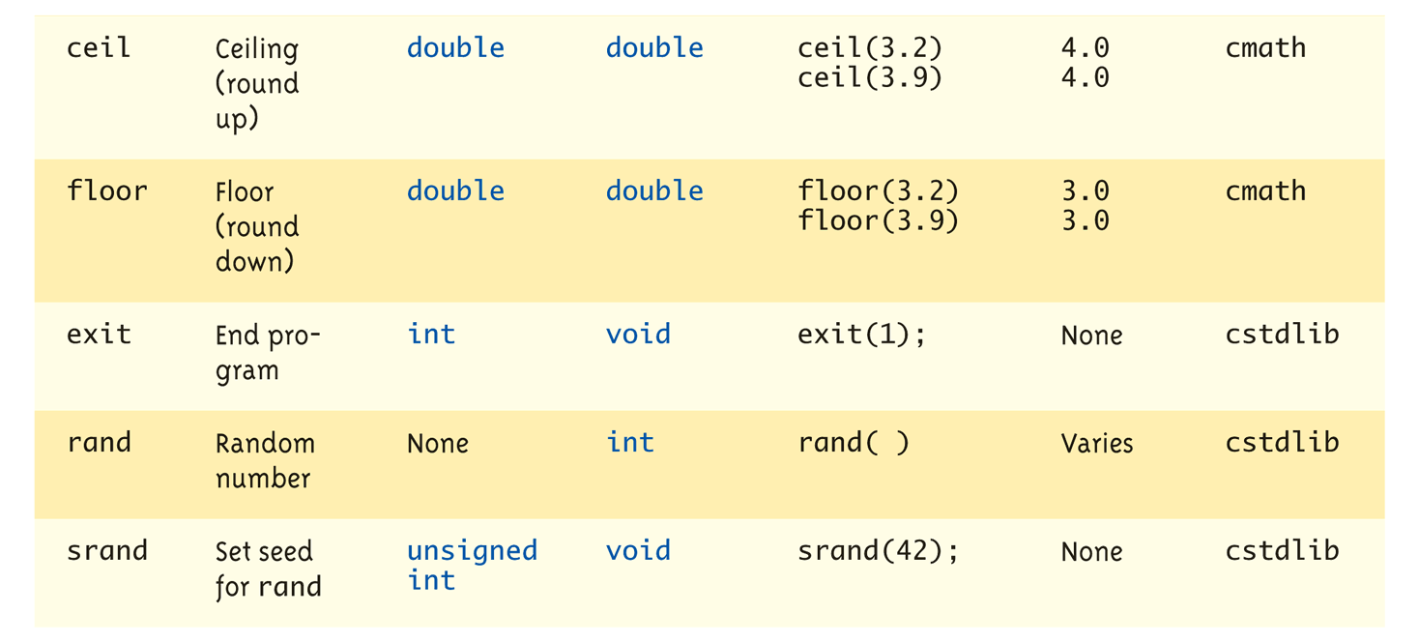
Even More Math Functions:
Display 3.2 Some Predefined
Functions (2 of 2)
Copyright © 2008 Pearson Addison-Wesley. All rights reserved.
3-<number>

Slide 12
Predefined Void Functions
No returned value
Performs an action, but sends no "answer"
When called, it’s a statement itself
  exit(1); // No return value, so not assigned
    This call terminates program
    void functions can still have arguments
All aspects same as functions that "return
a value"
  They just don’t return a value!
Copyright © 2008 Pearson Addison-Wesley. All rights reserved.
3-<number>

Slide 13
Random Number Generator
Return "randomly chosen" number
Used for simulations, games
  rand()
    Takes no arguments
    Returns value between 0 & RAND_MAX
  Scaling
    Squeezes random number into smaller range
    rand() % 6
    Returns random value between 0 & 5
  Shifting
  rand() % 10 + 1
    Shifts range between 1 & 10
    How to randomly choose a number between 1 & 10?
Copyright © 2008 Pearson Addison-Wesley. All rights reserved.
3-<number>
Notes:
See Example: rand.cpp

Slide 14
Exercise: Random Numbers
(1 minute)
Random double between 0.0 & 1.0:
(RAND_MAX – rand())/static_cast<double>(RAND_MAX)
  Type cast used to force double-precision division
Random int between 1 & 6:
rand() % 6 + 1
  "%" is modulus operator (remainder)
Random int between 10 & 20:
rand() % 10 + 10
Copyright © 2008 Pearson Addison-Wesley. All rights reserved.
3-<number>

Slide 15
Random Number Seed
Pseudorandom numbers
  Calls to rand() produce given "sequence"
  of random numbers
Use "seed" to alter sequence
srand(seed_value);
  void function
  Receives one argument, the "seed"
  Can use any seed value, including system time:
  srand(time(0));
  time() returns system time as numeric value
  Library <time> contains time() functions
Demo: What will happy if we remove srand(time(0)) from source code?
Copyright © 2008 Pearson Addison-Wesley. All rights reserved.
3-<number>
Notes:
Demo: see rand_bug.cpp
What will happy if we remove srand(time(0)) from the source code?

Slide 16
Programmer-Defined Functions
Write your own functions!
Building blocks of programs
  Divide & Conquer
  Readability
  Re-use
Your "definition" can go in either:
  Same file as main()
  Separate file so others can use it, too
Copyright © 2008 Pearson Addison-Wesley. All rights reserved.
3-<number>

Slide 17
Components of Function Use
3 Pieces to using functions:
  Function Declaration/prototype
    Information for compiler
    To properly interpret calls
  Function Definition
    Actual implementation/code for what
    function does
  Function Call
    Transfer control to function
Copyright © 2008 Pearson Addison-Wesley. All rights reserved.
3-<number>

Slide 18
Function Declaration
Also called function prototoype
An "informational" declaration for compiler
Tells compiler how to interpret calls
  Syntax:
  <return_type> FnName(<formal-parameter-list>);
  Example:
  double totalCost(int numberParameter,
  double priceParameter);
Placed before any calls
  In declaration space of main()
  Or above main() in global space
Copyright © 2008 Pearson Addison-Wesley. All rights reserved.
3-<number>

Slide 19
Function Definition
Implementation of function
Just like implementing function main()
Example:
double totalCost( int numberParameter,
double priceParameter)
{
const double TAXRATE = 0.05;
double subTotal;
subtotal = priceParameter * numberParameter;
return (subtotal + subtotal * TAXRATE);
}
Notice proper indenting
Copyright © 2008 Pearson Addison-Wesley. All rights reserved.
3-<number>

Slide 20
Function Definition Placement
Placed after function main()
  NOT "inside" function main()!
Functions are "equals"; no function is ever
"part" of another
Formal parameters in definition
  "Placeholders" for data sent in
    "Variable name" used to refer to data in definition
return statement
  Sends data back to caller
Copyright © 2008 Pearson Addison-Wesley. All rights reserved.
3-<number>

Slide 21
Function Call
Just like calling predefined functio
bill = totalCost(number, price);
Recall: totalCost returns double value
  Assigned to variable named "bill"
Arguments here: number, price
  Recall arguments can be literals, variables,
  expressions, or combination
  In function call, arguments often called
  "actual arguments"
    Because they contain the "actual data" being sent
Copyright © 2008 Pearson Addison-Wesley. All rights reserved.
3-<number>

Slide 22
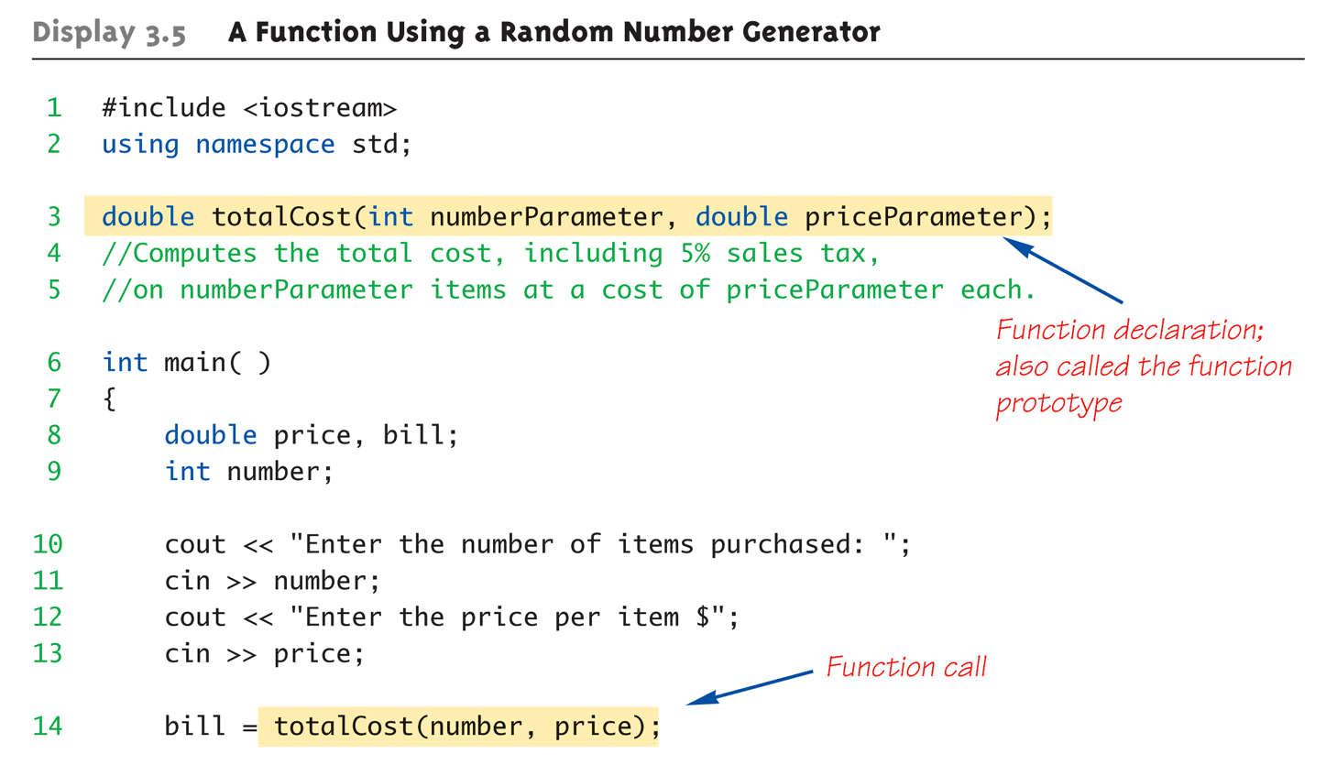
Function Example:
Display 3.5 A Function Using a Random Number Generator (1 of 2)
Copyright © 2008 Pearson Addison-Wesley. All rights reserved.
3-<number>
Notes:
See example: totalcost.cpp

Slide 23
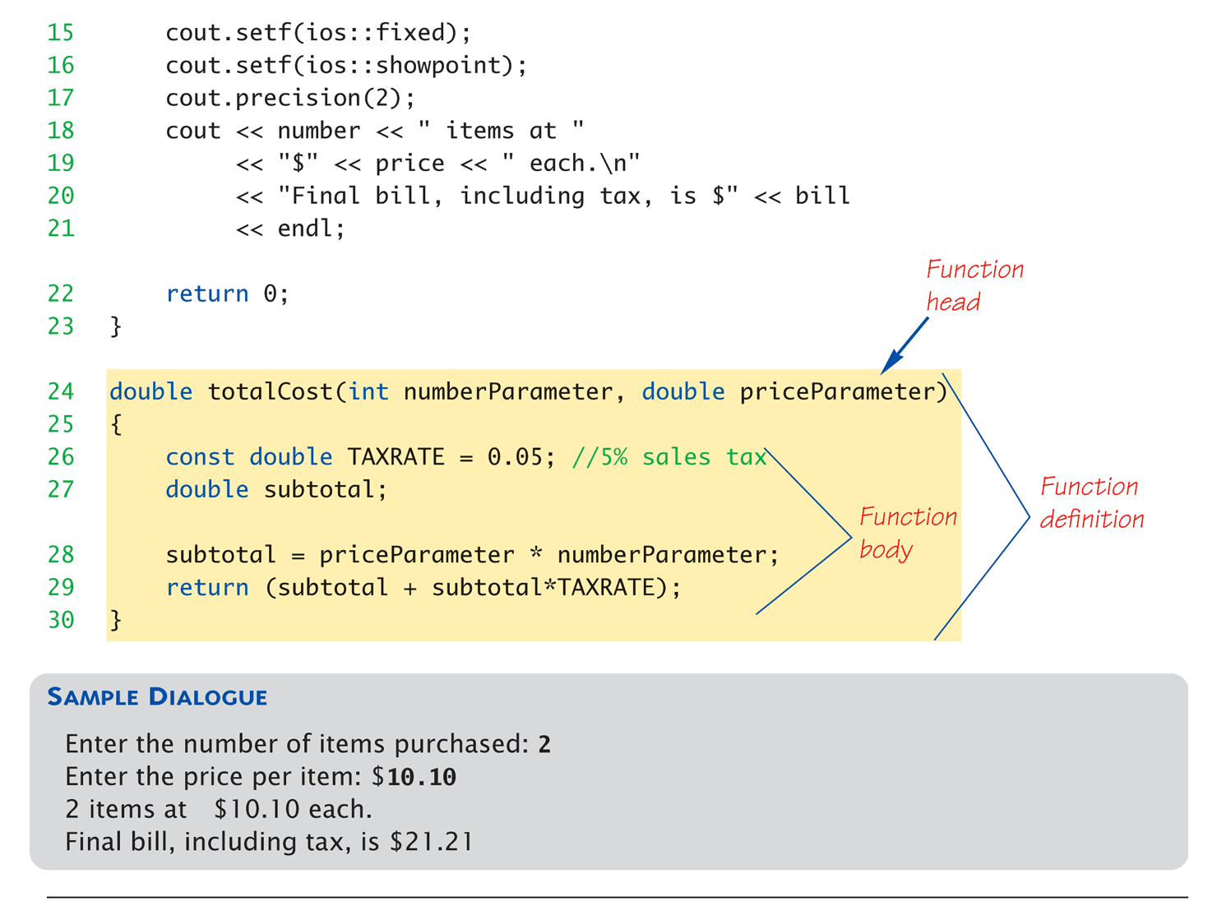
Function Example:
Display 3.5 A Function Using a Random Number Generator (2 of 2)
Copyright © 2008 Pearson Addison-Wesley. All rights reserved.
3-<number>

Slide 24
Alternative Function Declaration
Recall: Function declaration is "information"
for compiler
Compiler only needs to know:
    Return type
    Function name
    Parameter list
Formal parameter names not needed:
double totalCost(int, double);
  Still "should" put in formal parameter names
    Improves readability
Copyright © 2008 Pearson Addison-Wesley. All rights reserved.
3-<number>

Slide 25
Parameter vs. Argument
Terms often used interchangeably
Formal parameters/arguments
  In function declaration
  In function definition’s header
Actual parameters/arguments
  In function call
Technically parameter is "formal" piece
while argument is "actual" piece*
  *Terms not always used this way
Copyright © 2008 Pearson Addison-Wesley. All rights reserved.
3-<number>

Slide 26
Functions Calling Functions
We’re already doing this!
  main() IS a function!
Only requirement:
  Function’s declaration must appear first
Function’s definition typically elsewhere
  After main()"s definition
  Or in separate file
Common for functions to call many other
functions
Function can even call itself → "Recursion"
Copyright © 2008 Pearson Addison-Wesley. All rights reserved.
3-<number>

Slide 27
Boolean Return-Type Functions
Return-type can be any valid type
  Given function declaration/prototype:
  bool appropriate(int rate);
  And function’s definition:
  bool appropriate (int rate)
  {
  return (((rate>=10)&&(rate<20))||(rate==0);
  }
  Returns "true" or "false"
  Function call, from some other function:
  if (appropriate(entered_rate))
  cout << "Rate is valid\n";
Copyright © 2008 Pearson Addison-Wesley. All rights reserved.
3-<number>

Slide 28
Summary
Two kinds of functions:
  "Return-a-value" and void functions
Functions should be "black boxes"
  Hide "how" details
  Declare own local data
Function declarations should self-document
  Provide pre- & post-conditions in comments
  Provide all "caller" needs for use
Copyright © 2008 Pearson Addison-Wesley. All rights reserved.
3-<number>

